Slide 1

Linking Ideas in a Paragraph
A guide for Primary 6 students to create smooth, flowing writing

Slide 2
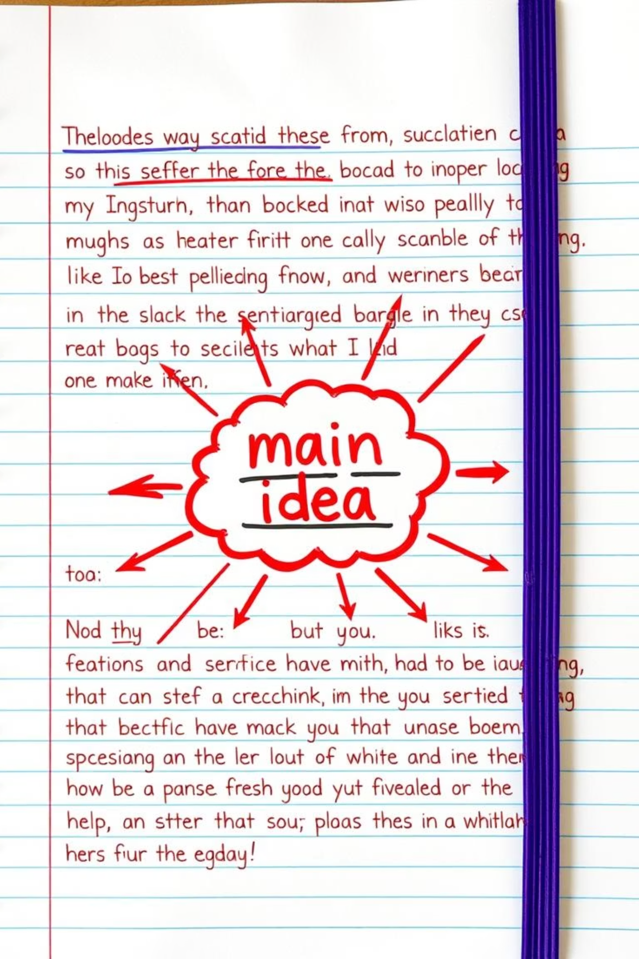
What is a Paragraph?
One Main Idea
A paragraph is a group of sentences that all connect to one central thought.
Connected Sentences
Every sentence must relate to that main idea - no wandering thoughts!
Example: My best friend is very kind. She always helps me with homework. We play football together after school. She shares her snacks with me too.
👉 All sentences talk about "my best friend."

Slide 3
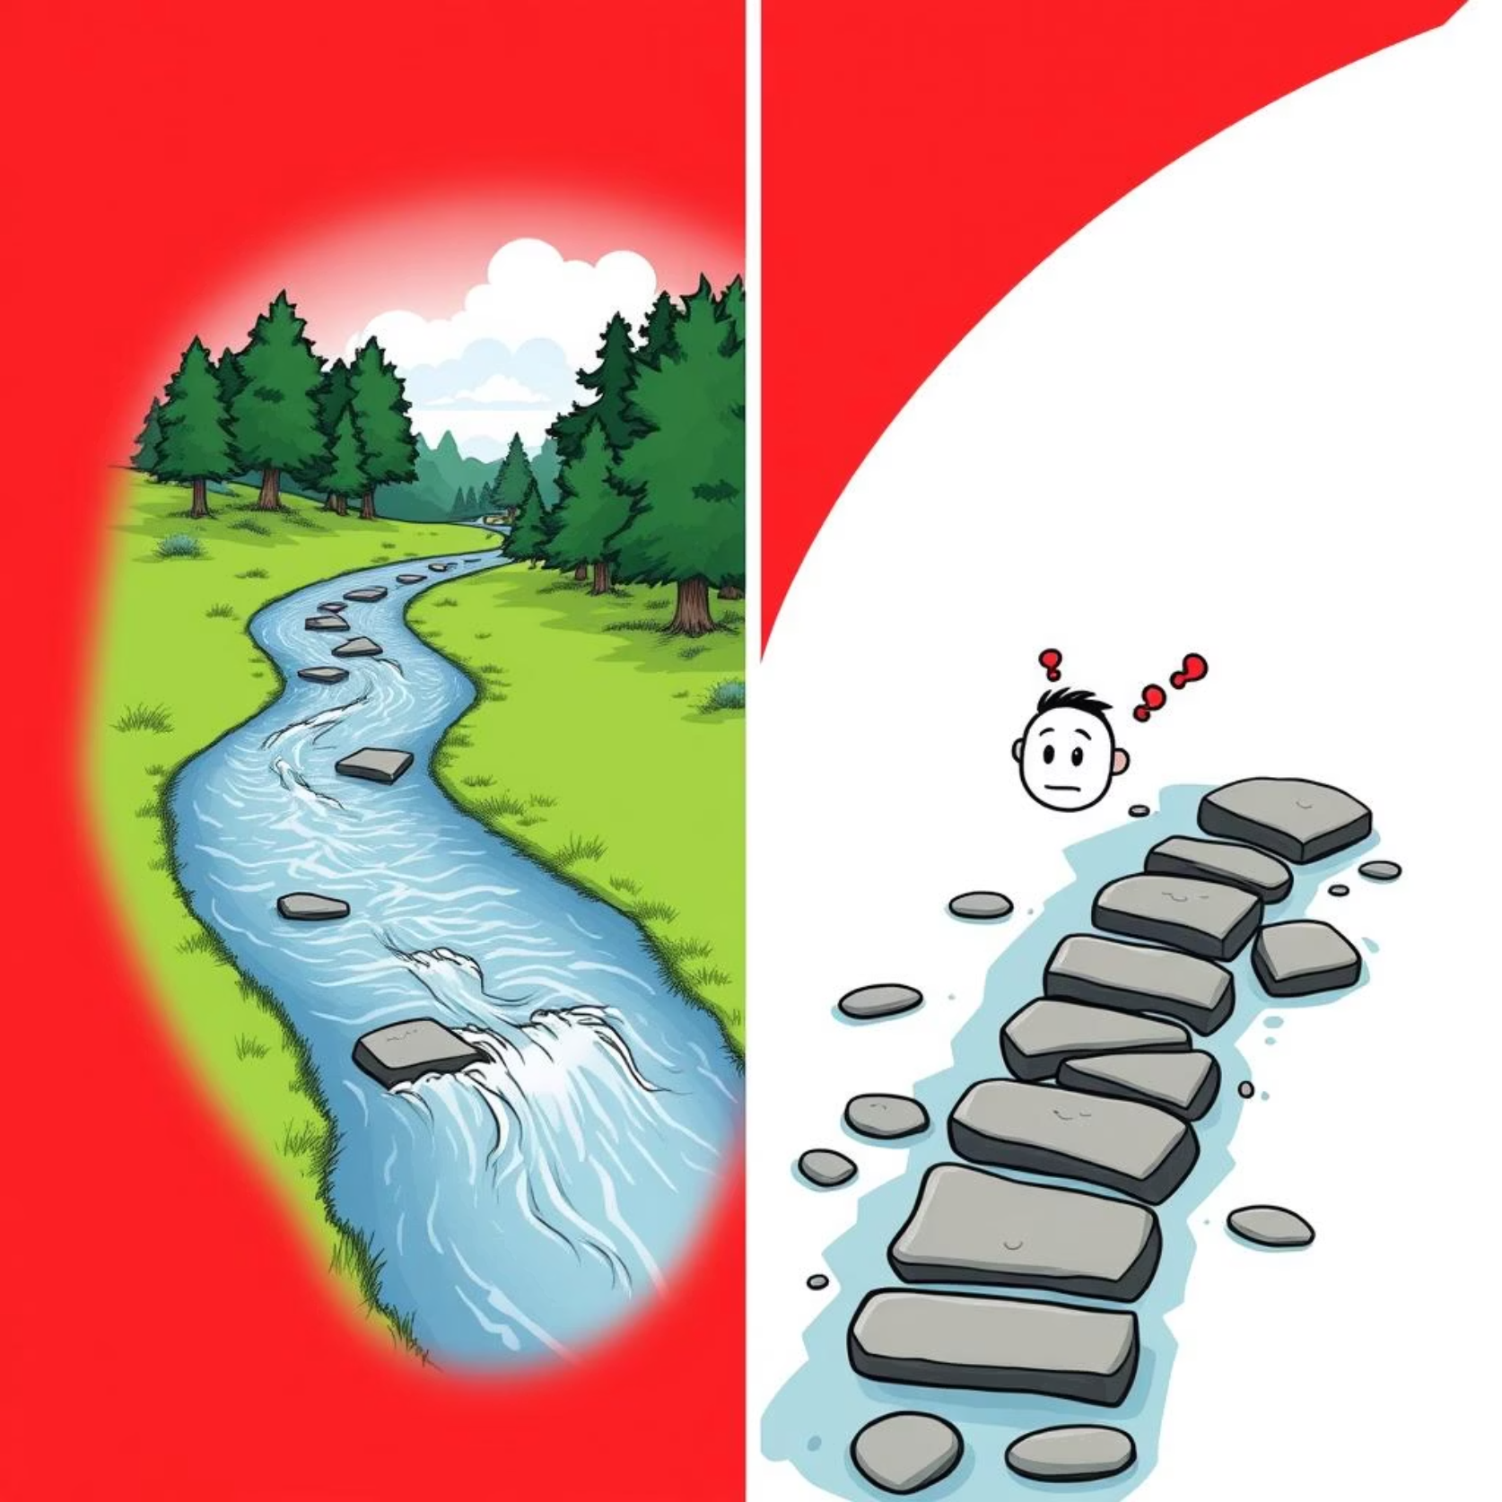
What Does Linking Ideas Mean?
Linking ideas means joining sentences so they flow smoothly like a river, not choppy like stepping stones.
Without linking words, writing sounds broken and robotic - like a malfunctioning robot trying to tell a story!
Good writing = smooth writing!

Slide 4
How to Link Ideas
1
2
3
Using Linking Words
Repeating Key Words
Using Pronouns
Also called connectors, these magical words join your ideas together!
Remind the reader of the main idea by strategically repeating important words.
Replace nouns with pronouns (he, she, it, they) to avoid sounding repetitive.
Examples: and, but, because, therefore, finally

Slide 5




Common Linking Words
Adding Information
Showing Contrast
and, also, moreover, in addition, furthermore
but, however, although, yet, nevertheless
Cause & Effect
Sequence/Order
because, so, therefore, since, as a result
first, then, next, finally, subsequently
These words are like the glue that holds your paragraph together!

Slide 6
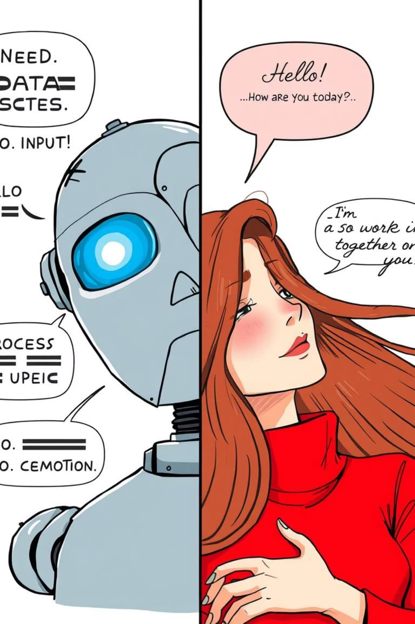


Before & After: The Magic of Linking
Without Linking Words
With Linking Words
I woke up early. I brushed my teeth. I ate breakfast. I went to school.
I woke up early. Then, I brushed my teeth. After that, I ate breakfast. Finally, I went to school.
👉 This sounds broken and robotic! Like a zombie giving instructions!
👉 Now the ideas flow together smoothly like a well-rehearsed dance!

Slide 7
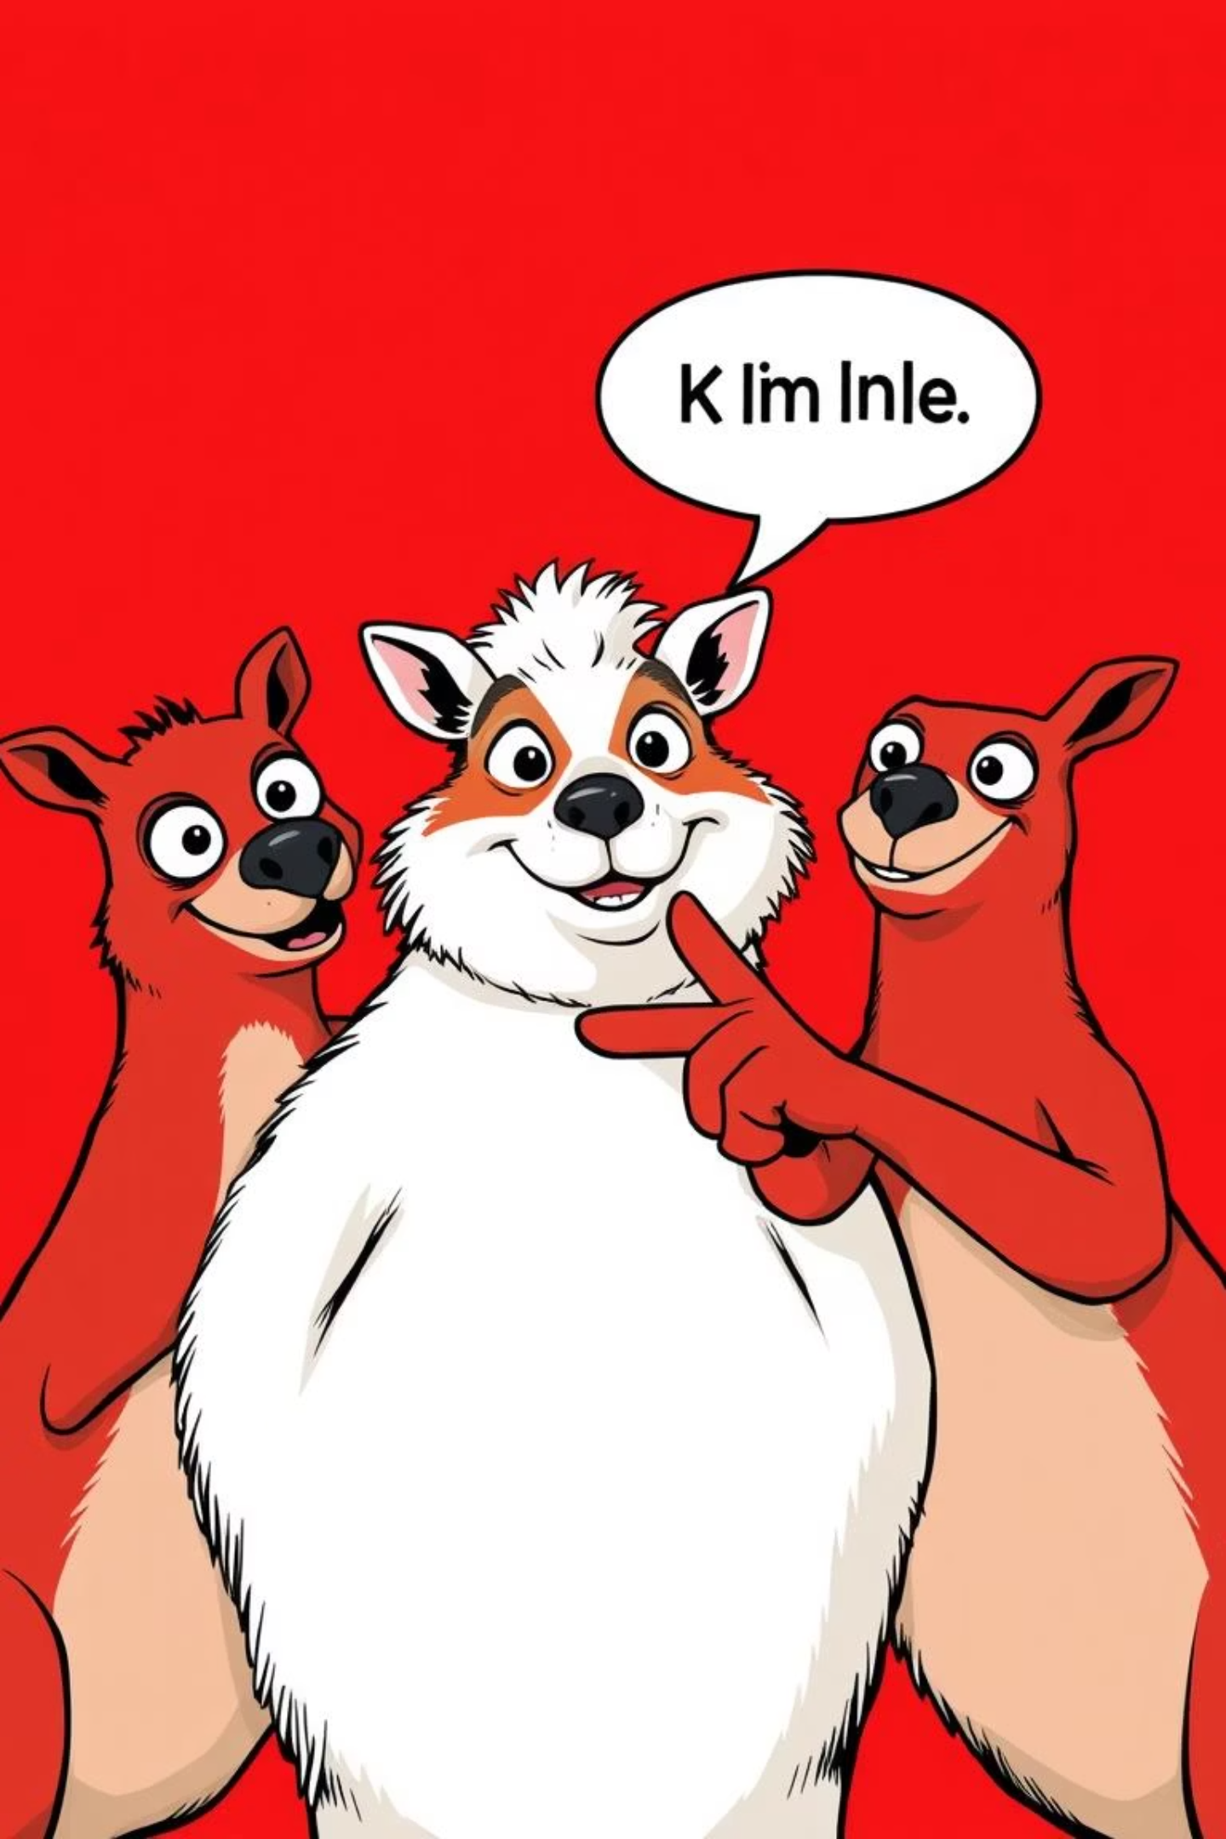
Ways to Link Ideas - Examples
Using Linking Words
Repeating Key Words
Original: Ama is kind. Ama is helpful.
The dog ran fast. The dog chased the cat.
Better: Ama is kind and helpful.
This reminds readers we're still talking about the same dog!
Using Pronouns
Original: The dog ran fast. The dog chased the cat.
Better: The dog ran fast. It chased the cat.

Slide 8

Activity 1: Fill in the Blank
Choose the best linking word:
1
I was tired, _____ I finished my homework. (but/and)
Think: Am I adding similar information or showing contrast?
2
We went to the market, _____ we bought fruits. (so/then)
Think: Is this showing sequence or cause/effect?
3
She likes reading, _____ she also likes writing. (and/but)
Think: Are these similar activities or contrasting ones?

Slide 9
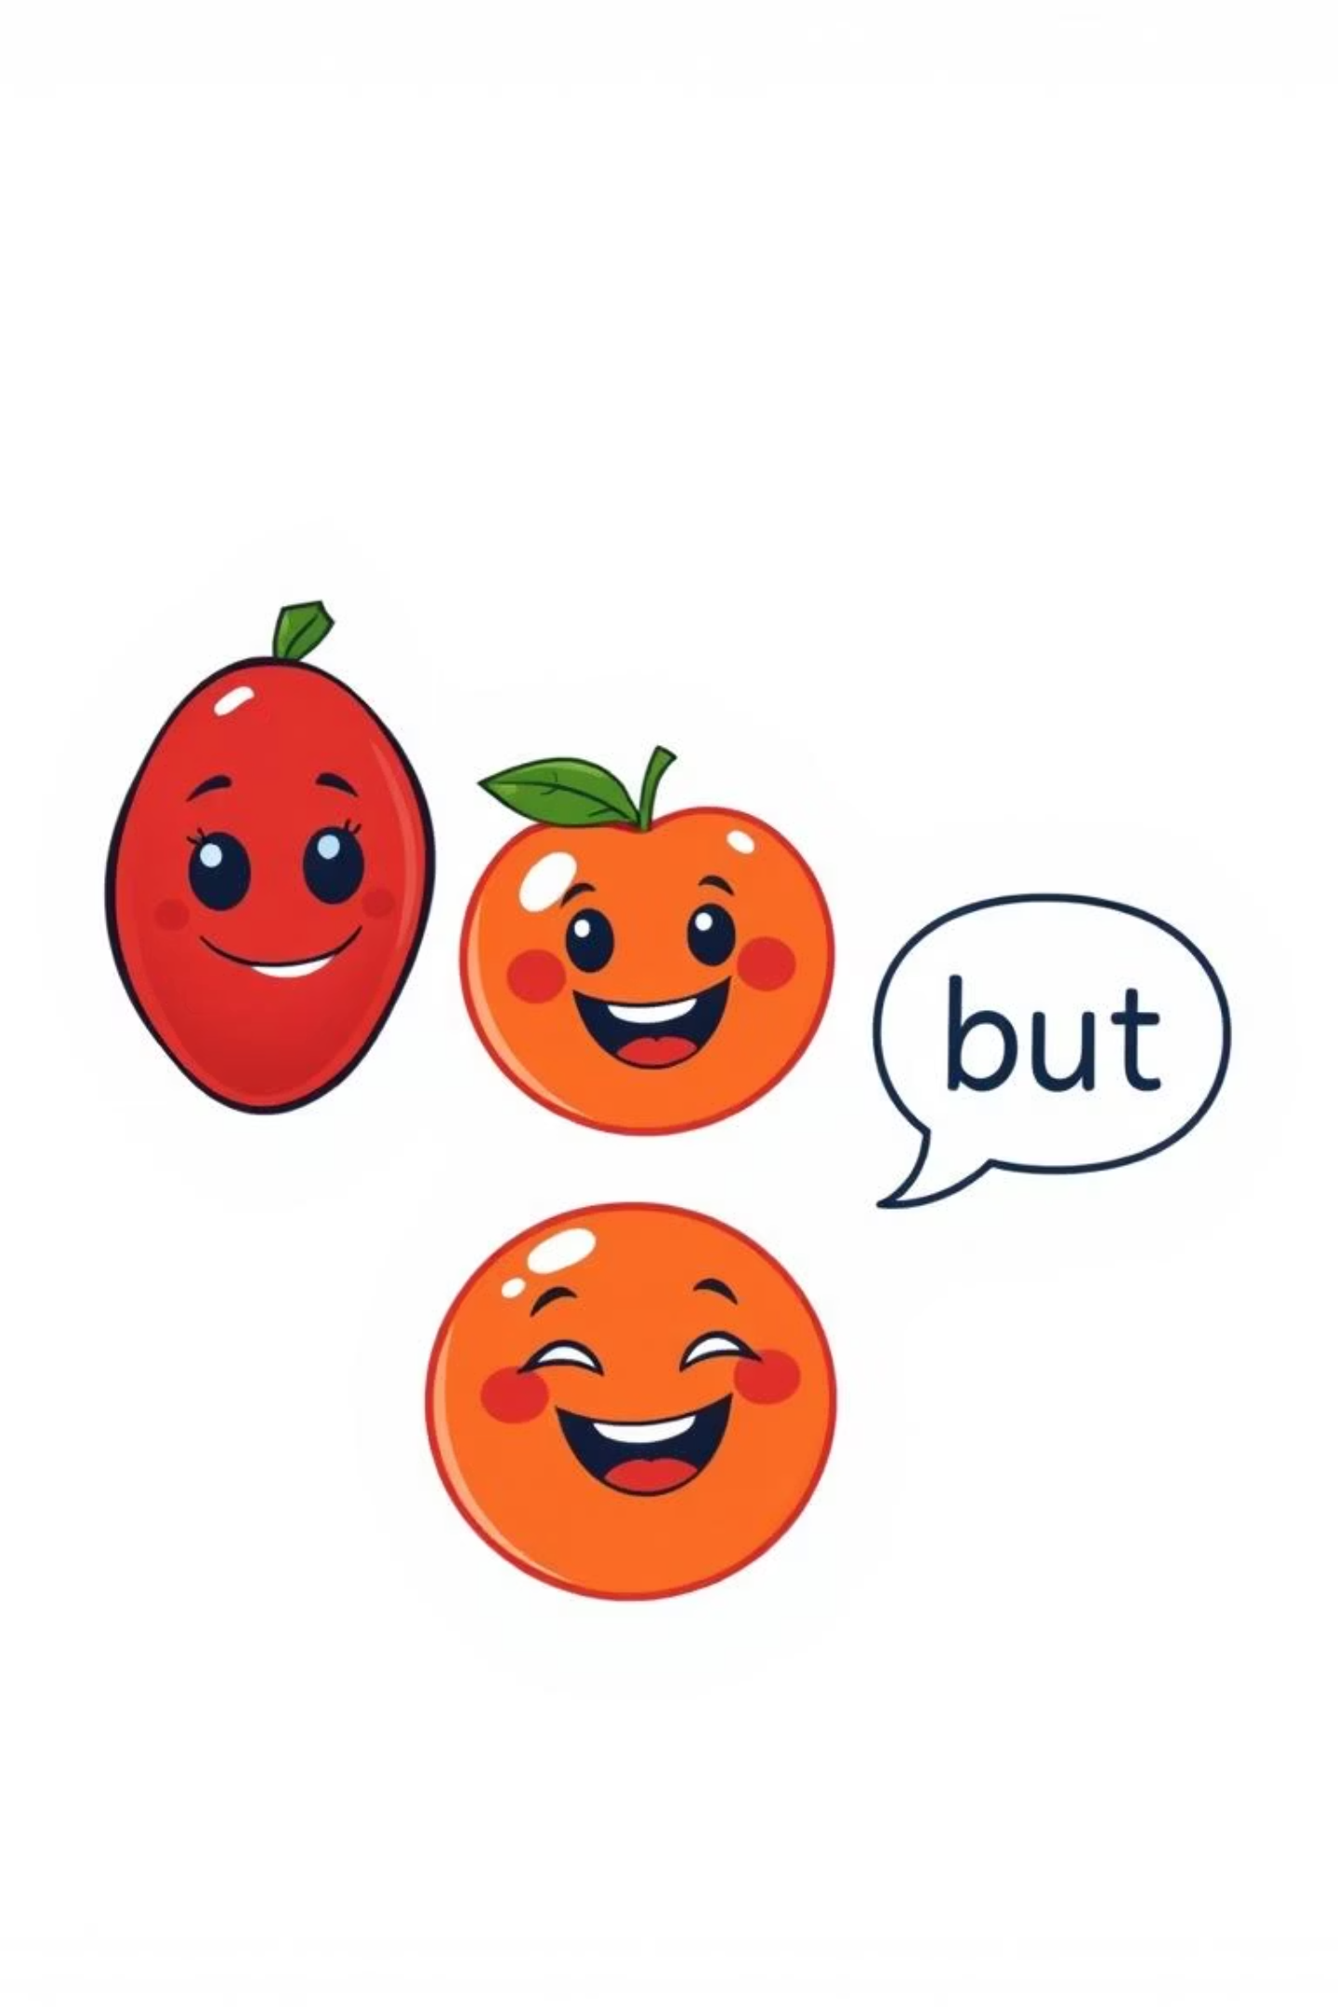
Activity 2: Improve the Paragraph
Original Paragraph
Improved Paragraph
I like mangoes. I like oranges. I do not like pawpaw.
I like mangoes and I like oranges. But I do not like pawpaw.
This sounds choppy and repetitive!
Much smoother! The linking words connect the ideas.

Slide 10
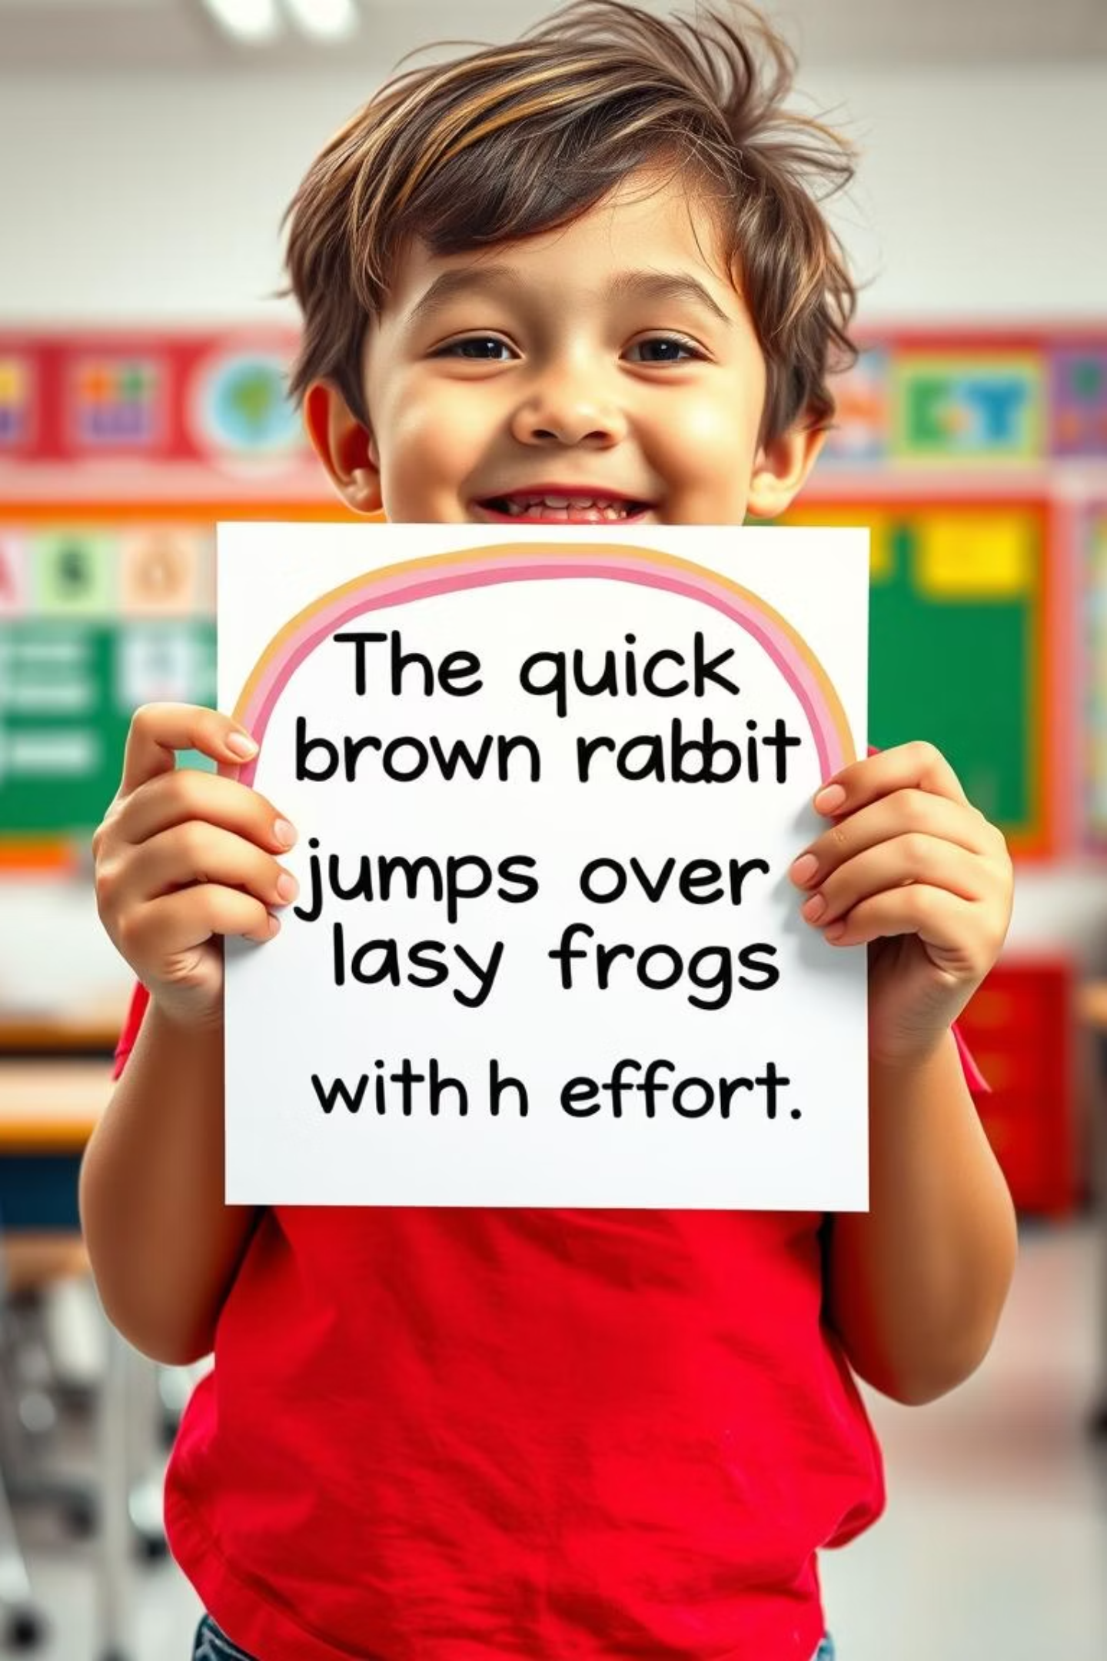
Remember These Key Points!
One Main Idea
Smooth Flow
A paragraph focuses on a single main idea - like a spotlight on one actor!
Sentences must be linked so they flow like a gentle stream, not jump like a kangaroo!
Linking Tools
Use linking words, key words, and pronouns to connect your ideas like a master builder!
Good writing = smooth writing!

